Slide 1

Code Splitting Using Lazy Components and Suspense

Slide 2
Objectives
Introduction to Code Splitting
Using the lazy() API
Using the Suspense component
Avoiding lazy components
Exploring lazy pages and routes

Slide 3
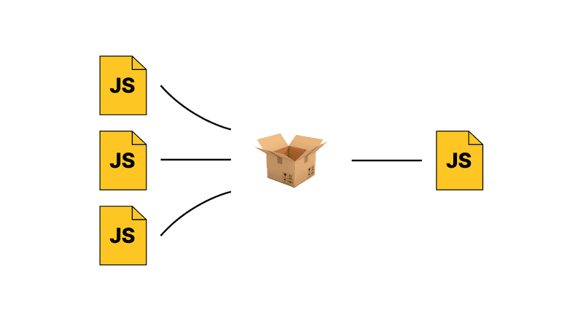
Introduction to Code Splitting
Big monolithic JavaScript bundles that house an entire application can create usability issues on initial page loads due to longer load times.
With code splitting, we have handle load-time User Experience (UX).
By using the lazy() API and the Suspense components, two recent additions to React, you'll be able to completely integrate code splitting into your applications.
We'll cover the following:
Using the lazy() API
Using the Suspense component
Avoiding lazy components
Exploring lazy pages and routes
Bundle all your JavaScript files into one single file

Slide 4
What is lazy API?
Lazy loading is a component or a part of code must get loaded when it is required. It is also referred to as code splitting and data fetching.
There are two pieces involved with using the new lazy() API in React.
First, there's bundling components into their own separate files so that they can be downloaded by the browser separately from other parts of the application.
Second, once you have created the bundles, you can build React components that are lazy – they don't download anything until the first time they're rendered.

Slide 5
How to use React.lazy
Step 1: Change the import to React.lazy
You can't use named exports with React.lazy. So something like the following won't work:
Step 2: Wrap the component in React Suspense
Any lazy-loaded component needs to be wrapped in React's Suspense component.
import MyComponent from './MyComponent';
const MyComponent = React.lazy(() => import('./MyComponent'));
// THAT DOESN'T WORK
const { MyComponent } = React.lazy(() => import('./MyComponent'));
const MyComponent = React.lazy(() => import('./MyComponent'));
const App = () => {
return (
<Suspense fallback={<span>Loading...</span>}>
<MyComponent />
</Suspense>
);
};

Slide 6
Simulating latency
import React, { Suspense} from 'react';
const MyFeature = React.lazy(() =>
Promise.all([
import("./MyComponent"),
new Promise((resolve) => {
setTimeout(() => {
resolve();
}, 3000);
}),
]).then(([m]) => m)
);
function App() {
return (
<>
<h1>My Page</h1>
<MyFeature />
</>
);
}
export default App;
The whole idea with the lazy() and Suspense APIs is to provide a better user experience for both of the following:
The initial load, by splitting code into bundles so that the whole app doesn't have to be downloaded upfront.
Providing consistent fallback content while code bundles load.

Slide 7
Dynamic imports and bundles
Dynamic imports allow you to dynamically load JavaScript modules at runtime.
This improves the performance and page loading speed of the application, especially when there are elements or features that are not necessary to be loaded upfront.
Bundles are collections of JavaScript source code files that are bundled together into a single file or a group of files, used to load and run an application.

Slide 8

Dynamic imports and bundles – cont’d
import * as React from "react";
function MyComponent() {
return <p>My Component</p>;
}
export default MyComponent;
import React from 'react';
function App() {
const [MyComponent, setMyComponent] = React.useState (() => () => null);
React.useEffect(() => {
import("./MyComponent").then((module) => {
setMyComponent(() => module.default);
});
}, []);
return <MyComponent />;
}
export default App;

Slide 9
Making components lazy
Instead of manually handling the promise returned by import() by returning the default export and setting state.
This function takes a function that returns an import() promise.
import React, { Suspense } from 'react';
import MyComponent from './MyComponent';
function App() {
return (
<Suspense fallback={"loading..."}>
<MyComponent />
</Suspense>
);
}
export default App;

Slide 10
Using the Suspense component
Suspense is a new feature that lets your component “wait” for something before it can render. Some of the use cases where it is used are data fetching and waiting for images, scripts, and other asynchronous work to load.
Suspense does not detect when the data is fetched inside an Effect or Event handler.

Slide 11
Props for Suspense Component
children: They are the actual UI you intend to render. The Suspense boundary will switch to render fallback when the children takes too long to render.
fallback: It is a lightweight placeholder view such as a loading spinner, An alternate UI to render in the place of the actual UI if it has not finished loading.
Suspense will automatically switch to fallback when children suspends, and back to children the data is ready. If fallback suspends while rendering, it will activate the closest parent Suspense boundary.

Slide 12

Display a fallback while the content is loading
React will display your loading fallback until all the code and data needed by the children has been loaded.
import * as React from "react";
import Loading from "./Loading";
export default function MyComponent() {
// State to track the loading status
const [isLoading, setIsLoading] = React.useState(true);
// Simulate loading time using useEffect
React.useEffect(() => {
const timer = setTimeout(() => {
setIsLoading(false);
}, 2000);
return () => clearTimeout(timer);
}, []);
if (isLoading) {
return <Loading />;
}
return <p>My Component</p>;
};
import React, { Suspense } from 'react';
import MyComponent from './MyComponent';
import Loading from './Loading';
export default function App() {
return (
<Suspense fallback={<Loading />}>
<MyComponent />
</Suspense>
);
};
export default function Loading() {
return <h2>🌀 Loading...</h2>;
};

Slide 13
Revealing content together at once
By default, the whole tree inside the Suspense boundary is treated as a single unit.
For example, even if only one of these components suspends wait for some data, all of them together will be replaced by the loading spinner. After all of them are ready to be displayed, they will all appear together at once.
Components that load does not have to be direct children of the Suspense boundary.
<Suspense fallback={<Loading />}>
<Panel />
<List>
<Albums />
</List>
</Suspense>

Slide 14
Working with spinner fallbacks
The simplest fallback that you can use with the Suspense component is some text that indicates to the user that something is happening.
The fallback property can be any valid React element, which means that we can enhance the fallback to be something more visually appealing.
For example, the react-spinners package has a selection of spinner components, all of which can be used as a fallback with Suspense.
npm i react-spinners@0.13.8

Slide 15
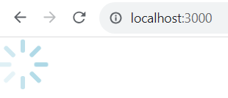
Working with spinner fallbacks – cont’d
import {lazy } from 'react';
const MyFeature = lazy(() =>
Promise.all([
import("./MyFeature"),
new Promise((resolve) => {
setTimeout(() => {
resolve();
}, 3000);
}),
]).then(([m]) => m)
);
import { FadeLoader } from 'react-spinners';
import { Suspense} from 'react';
function App() {
return (
<div className='App'>
<Suspense fallback={<FadeLoader
color={"lightblue"} size={150} />}>
<MyFeature/>
</Suspense>
</div>
);
}
export default App;
import React from "react";
export default function MyFeature() {
return <p>My Feature</p>;
}

Slide 16
Avoiding lazy components
Too many lazy components, app will end up making several HTTP requests to fetch them – at the same time.
Tetter off trying to bundle components together in a way that one HTTP request is made to load what is needed on the current page.
A helpful way to think of this is to associate "pages" with bundles

Slide 17
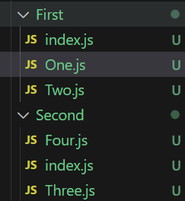
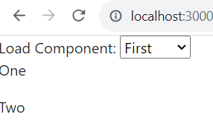
Avoiding lazy components – cont’d
import { Suspense, lazy, useState } from 'react';
import { FadeLoader } from 'react-spinners';
const First = lazy(() => import("./First"));
const Second = lazy(() => import("./Second"));
function ShowComponent({ name }) {
switch (name) {
case "first": return <First />;
case "second": return <Second />;
default: return null;
}
}
function App() {
const [component, setComponent] = useState(""); return (
<>
Load Component:{" "}
<select value={component} onChange={(e) => setComponent(e.target.value)}>
<option value="">None</option>
<option value="first">First</option>
<option value="second">Second</option>
</select>
<Suspense fallback={<FadeLoader/>}>
<ShowComponent name={component} />
</Suspense>
</>
);
}
export default App;
import * as React from "react";
import One from "./One";
import Two from "./Two";
export default function First() {
return (
<>
<One />
<Two />
</>
);
}
import React from "react";
export default function One() {
return <p>One</p>;
}

Slide 18
Exploring lazy pages and routes
The children of the Suspense component are the Route components that will render our lazy page components
For example, when the /first route is activated, the First component is rendered for the first time, triggering the bundle download.

Slide 19
Exploring lazy pages and routes – cont’d
import { Suspense, lazy } from "react";
const First = lazy(() =>
Promise.all([
import("./First"),
new Promise((resolve) => {
setTimeout(() => {
resolve();
}, 3000);
}),
]).then(([m]) => m)
);
const Second = lazy(() =>
Promise.all([
import("./Second"),
new Promise((resolve) => {
setTimeout(() => {
resolve();
}, 3000);
}),
]).then(([m]) => m)
);
import {Link, Outlet } from "react-router-dom";
import { Suspense} from "react";
function Layout() {
return (
<section>
<nav>
<p>
<Link to="first">First</Link>
</p>
<p>
<Link to="second">Second</Link>
</p>
</nav>
<section>
<Suspense
fallback={<FadeLoader color={"lightblue"}
size={150} />}
>
<Outlet />
</Suspense>
</section>
</section>
);
}

Slide 20
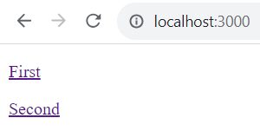
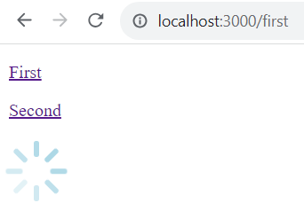
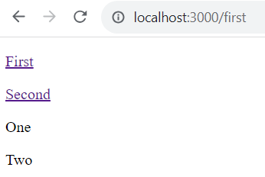
Exploring lazy pages and routes – cont’d
import { BrowserRouter as Router, Routes, Route} from "react-router-dom";
function App() {
return (
<>
<Router>
<Routes>
<Route path="/" element={<Layout />}>
<Route path="/first" element={<First />} />
<Route path="/second" element={<Second />} />
</Route>
</Routes>
</Router>
</>
);
}
export default App;

Slide 21
Exercise 23: Demo about Code Splitting using Lazy Component

Slide 22
Summary
Concepts were introduced:
Introduction to Code Splitting
Using the lazy() API
Using the Suspense component
Avoiding lazy components
Exploring lazy pages and routes

